Slide 1

Industrial Training – ETP Viva
Student Name :- Ekhlakh Ahmad
Reg. No. : - 12209166
Program : - MCA
Course Code : - CAP-841
Company Name: - Acacious Technologies
Designation : - Software Trainee Intern

Slide 2

About of Company
Acacious Technologies is a leading IT and digital marketing company specializing in Search Engine Optimization (SEO), web design, web development, mobile application development, and digital marketing services. With over a decade of experience, we have successfully served a diverse range of clients, from small businesses to large organizations, helping them achieve top search engine rankings, increased website visibility, and quality traffic.

Slide 3
Job Description
Website Development: Design, develop, and implement responsive websites using HTML, CSS, JavaScript, and related technologies to ensure cross-platform compatibility and an optimal user experience across devices.
Responsive Design: Convert static website designs into fully responsive layouts, ensuring seamless functionality on desktops, tablets, and mobile devices. This includes optimizing images, utilizing media queries, and implementing flexible grid systems.
Existing Projects: Collaborate with the team to enhance and modify existing projects, focusing on improving responsiveness and overall site performance. Ensure that legacy code is updated and modernized according to the latest standards.

Slide 4
Code Quality: Write clean, maintainable, and well-documented code, following industry standards and company guidelines. Regularly participate in code reviews and provide constructive feedback to peers.
Optimization: Implement best practices for web performance optimization, including minimizing load times, improving site speed, and ensuring scalability.
Problem Solving: Identify and resolve front-end related issues, bugs, and discrepancies across different browsers and devices, ensuring a consistent user experience.

Slide 5

Learnings
Git & GitHub
Responsive
Firebase
API
Hosting

Slide 6

Git & GitHub
Git is a distributed version control system that tracks changes in the source code during software development. It allows multiple developers to work on the same project simultaneously without interfering with each other’s work.
Repository (Repo): A directory that contains all the project files and the entire history of changes made to those files.
Commit: A snapshot of the repository at a specific point in time. Each commit has a unique ID.
Branch: A parallel version of the repository. Branches allow developers to work on features, fixes, or experiments in isolation from the main codebase.
Push: Sending your committed changes from your local repository to a remote repository.

Slide 7

Responsive
Fluid Grid Layouts: Responsive websites use fluid grids where elements are sized proportionally, rather than with fixed dimensions. This allows the layout to resize and rearrange itself based on the screen size.
Flexible Images and Media: Images, videos, and other media are scaled within the content and are often set to a percentage of their container, ensuring they resize properly on different devices without breaking the design or causing scrolling issues.
Media Queries: These are a critical part of responsive design. Media queries are CSS techniques that apply different styling rules based on the device's characteristics, such as its screen width or resolution. This allows a website to adjust its design at specific breakpoints, like when the screen size changes from tablet to smartphone.
Mobile-First Design: This approach prioritizes the mobile user experience by designing the website for smaller screens first and then scaling up for larger screens. This is critical as mobile device usage continues to rise.
Viewport Meta Tag: Essential for ensuring that a website is properly scaled on mobile devices, this tag controls the layout width and scaling of the website on different devices.

Slide 8
Firebase
Real-time Database: Firebase offers a NoSQL cloud database that allows data to be stored and synchronized in real-time across all clients. This is particularly useful for applications where live data is critical, such as chat apps or collaborative platforms.
Authentication: Firebase Authentication simplifies the process of managing user authentication. It supports sign-ins using passwords, phone numbers, Google, Facebook, Twitter, and other social platforms.
Cloud Storage: Firebase Storage provides a powerful, simple, and cost-effective object storage service, especially useful for storing user-generated content like photos and videos.

Slide 9
API (Application Programming Interface)
An API (Application Programming Interface) is a set of rules and protocols that allows different software applications to communicate with each other.
Endpoints: An API endpoint is a specific path where an API interacts with another software component.
Requests and Responses: APIs work on a request-response model. A client sends a request to an API endpoint, and the server responds with the required data or performs the requested action. Common request types include GET (retrieve data), POST (submit data), PUT (update data), and DELETE (remove data).
Data Format: APIs typically exchange data in a structured format. JSON (JavaScript Object Notation) is the most common format, though XML (eXtensible Markup Language) is also used. These formats allow for easy data serialization and deserialization across different systems.

Slide 10
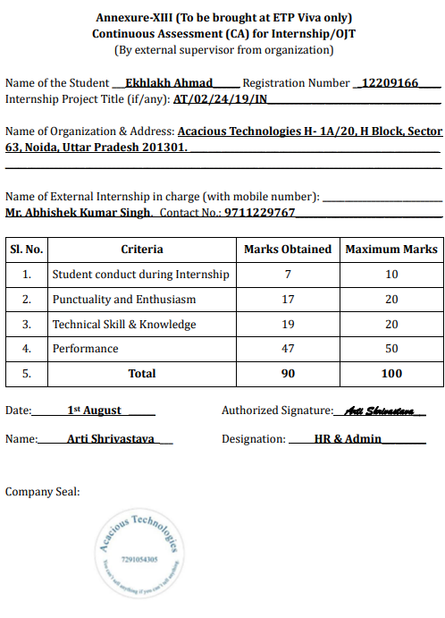

Slide 11


THANK YOU

